Slide 1
3D vs 2D model module displacement
lack of constraint in 2D model results in unrealistically large out of plane displacements
rudimentary 3D model is therefore used to interpret 2D model
5400 Pa is evaluated at 4400 Pa
2400 Pa is evaluated at 1800 Pa

Slide 2
Dotted lines represent the material property that defines the fracture criterion for the weld.
The goal of our experimental work is to measure this property (K_{ic} and K_{iic}) for our glass welding process, and thereby determine if/when a glass welded module will fail.

Slide 3
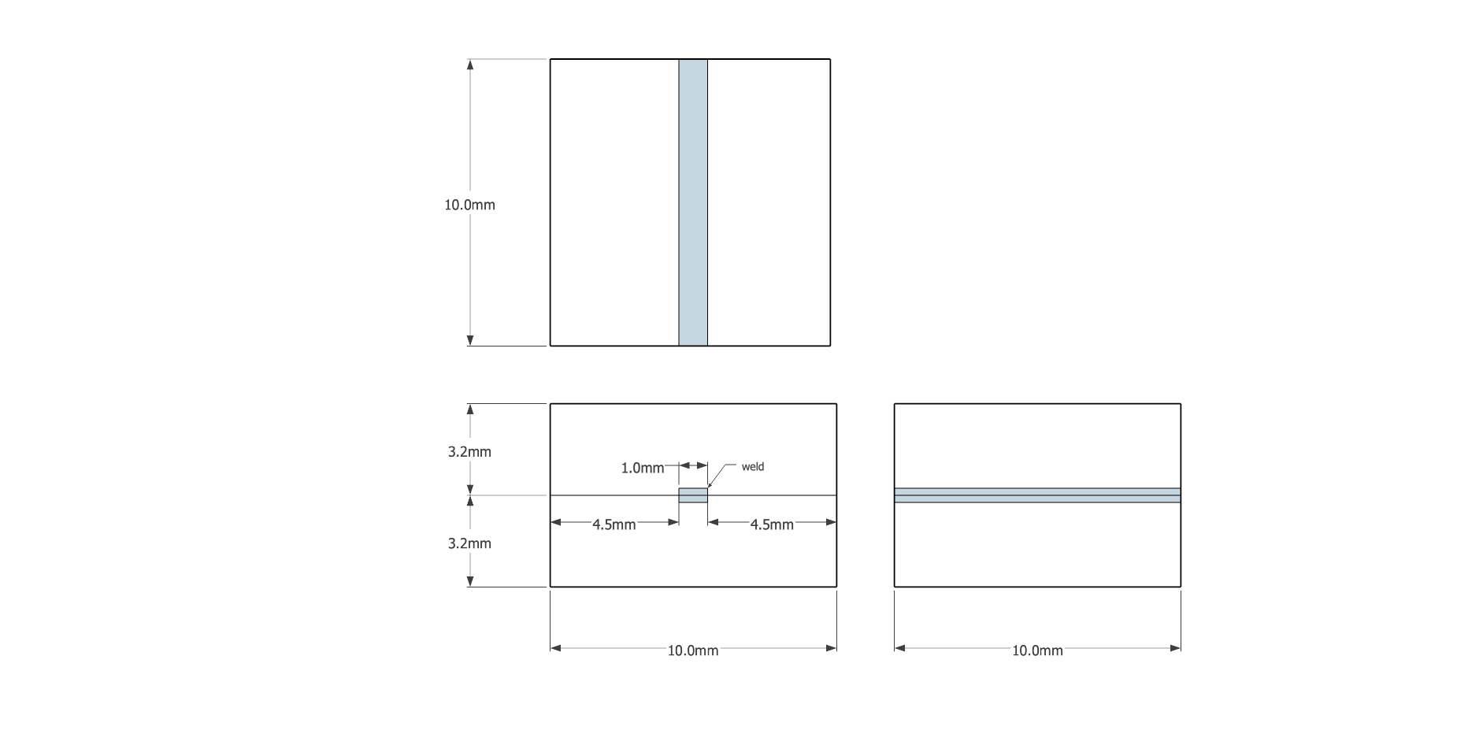
For K_{ic}:
Classical fracture mechanics solution
Glass weld sample and testing

Slide 4
For K_{iic}:
Classical fracture mechanics solution
Glass weld sample and testing

