Slide 1
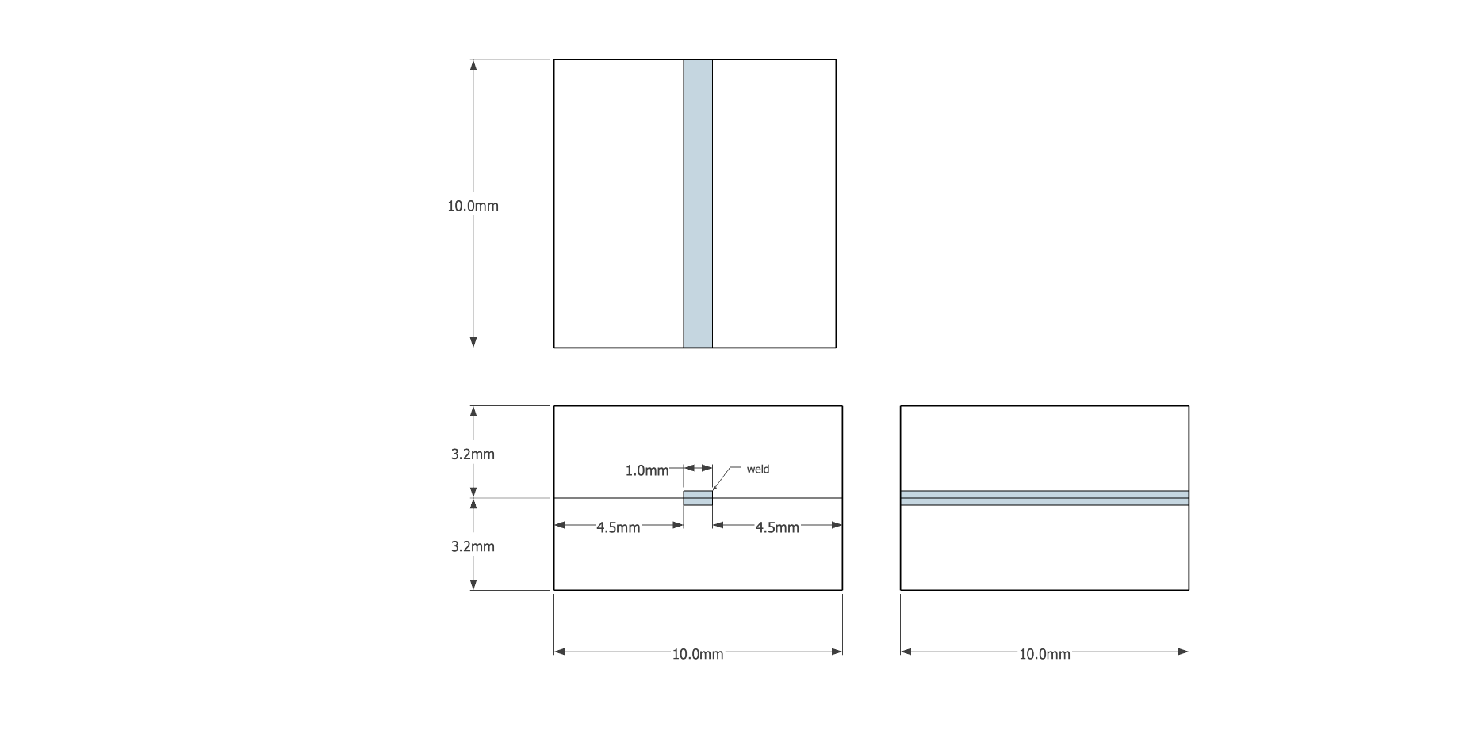
Goal: strongest weld possible
Critical weld width ~ 1 mm
(for standardized weld test at NREL)
Glass sample dimensions and weld placement
C
Glass = 10 mm x 10 mm x 3.2 mm thick
Proposed weld parameters: 50 µm wide weld seams (continuous if possible), 6 seams, 150 µm between seams.
Proposed weld pattern
Top view C
B
1 mm
A
Laser weld (multiple passes)
50 µm
150 µm
Side view B
Side view A
(looking along the weld)

